Slide 1
Umati (Phase 1):
Monitoring online Dangerous speech in Kenya
Sidney Ochieng
@princelySid
Notes:
Thus far, most regulation against speech has been around punishment and censorship. But why not do more work focusing instead on the audience.
online world has had really only 1 response to content online. don't feed the trolls (ignore the inflammatory speaker). we don't have evidence that that works.
look, it's obviously a really bad problem. solutions we have are inadequate. just beginning to explore alternatives. brand new effort to brainstorm new approaches.
---
- why it IS important to monitor (see what happened in 2007/2008)
- here's what we have done
- here are the challenges we are facing/faced
how do YOU think we can tackle them!?
<number>

Slide 2
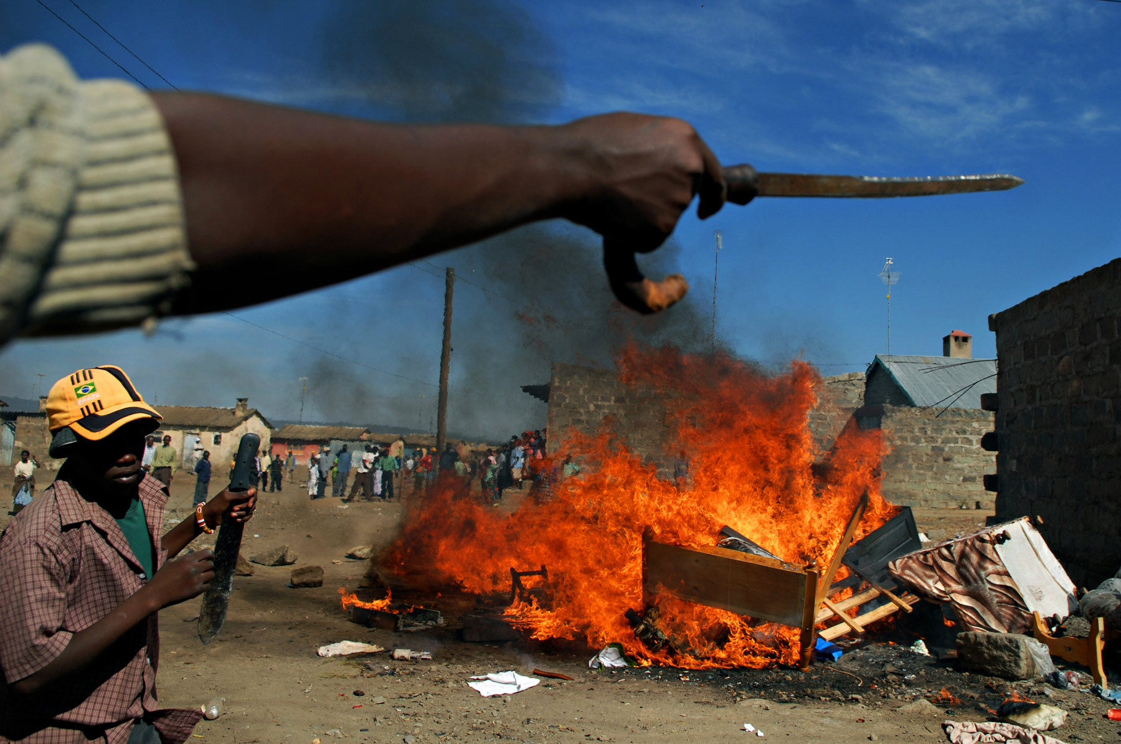
“From the little spark may burst a mighty flame.” - Dante
Notes:
Yesterday Nanjira gave you a history of politically motivated violence that occurs in Kenya around election period. Umati was motivated by use of hate speech to fuel the 2007/8 tensions in the country.
At the end of 2007 after a hurried swearing in of Mwai Kibaki as Kenya’s president, the country went into widespread violence. Violence during elections was not new in the country but the scale and speed of the violence was unprecedented.
Over 1,000 people killed; 600,000 people displaced.
The great violence that happened in 2007/8 during the Kenyan general elections is what inspired Umati to take place
<number>

Slide 3
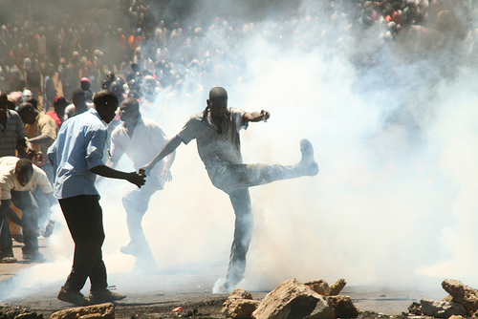

Notes:
5 years later, mobile phone subscribers in Kenya went from 8 million to 30 million with many accessing internet through feature phones.
So instead of people demonstrating on the streets, they demonstrate in the comfort of their houses.
Almost 20 million internet users in Kenya with 99% of them using it on their mobile devices.
Everyone who accesses the internet in Kenya does so also on their mobile phones.
Also, growing internet use in Kenya:
- 82.7% increase over 12 months between June 2011 and June 2012.
- Half the internet users are on Facebook.
8 month project
Monitoring dangerous speech online
Goal : To provide a definition of dangerous speech, and raise the alarm when it is identified
Picture sources:
http://www.walterastrada.com/data/photos/74_1009_post_electoral_violence_in_kenya.jpg
http://bossip.files.wordpress.com/2012/08/black-man-on-the-computer.jpg#.UP-uhif64rU
<number>

Slide 4

UMATI PROJECT GOALS (PHASE 1):
To propose both a workable definition of hate speech and a contextualized methodology for online hate speech tracking, that can be replicated locally and in other countries.
To collect and monitor the occurrence of hate speech in the Kenyan online space.
To forward any distress calls the Umati team came across online to Uchaguzi.
To further education on the possible outcomes of hate speech, so as to promote civil communication and interaction in both online and offline spaces.
Notes:
Uchaguzi was a technology-based system that enables citizens to report and keep an eye on election-related events on the ground.
<number>

Slide 5
GOAL 1: Definition and Methodology
Incomprehensive definition of hate speech under the National Cohesion and Integration Act, 2008.
(sections 13 and 52)
Ethnicity, nationality or race
Intent or likelihood
Notes:
Definition of hate speech
The 2008 law defines hate speech as that which advocates or encourages violent acts against a specific group, and creates a climate of hate or prejudice, which may, in turn, foster the commission of hate crimes.
<number>

Slide 6
Adopting the Dangerous Speech Framework
The speaker and his/her influence over a given audience.
A receptive audience subject to incitement by speaker.
Speech content understood as a call to violence.
Social and historical context of the speech.
Medium of disseminating speech, including language
Notes:
<number>

Slide 7
Identification of Online Dangerous Speech in Kenya
Targets a group of people – hate comment about an individual isn’t hate speech unless it targets the person as a member of a group
Contains one of the hallmarks/pillars of dangerous speech:
Compares a group of people to insects, animals or vermin
Suggests audience faces a serious threat or violence from another group (Accusation in a mirror)
Suggests that people from another group are spoiling the purity or integrity of the speaker’s group.
3. Contains a call to action – calls to discriminate, loot, riot, beat, forcefully evict or kill
Notes:
<number>

Slide 8
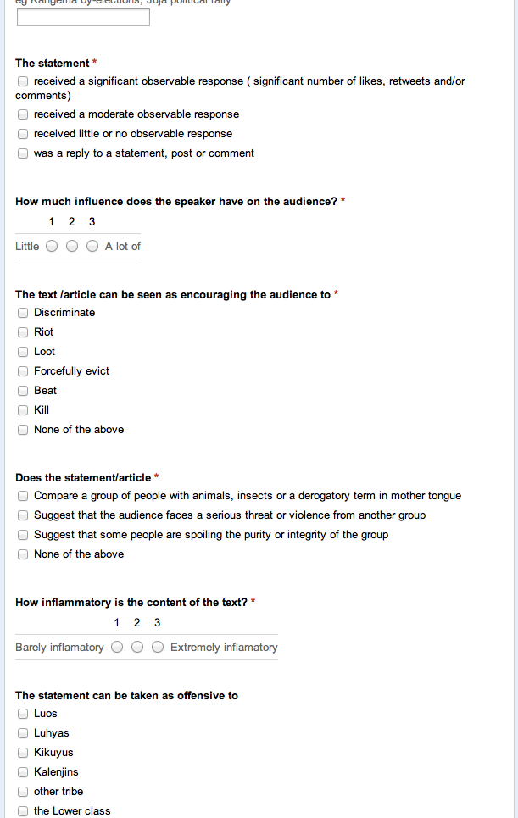
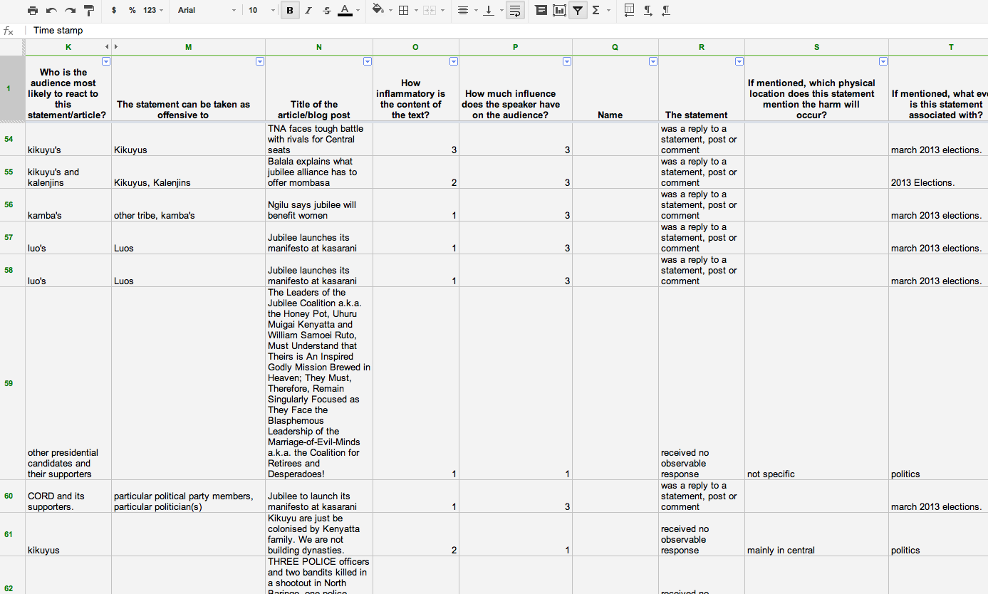


Categorization Formula
M1 + N1 = Bucket 1
M1 + N2 = Bucket 1
M1 + N3 = Bucket 2
M2 + N1 = Bucket 2
M2 + N2 = Bucket 2
M2 + N3 = Bucket 3
M3 +N1 = Bucket 3
M3 + N2 = Bucket 3
M3 + N3 = Bucket 3
Notes:
- People : We had swiftriver, but it did not work out. You cannot eliminate people.
Three buckets
Form
Formula
<number>

Slide 9
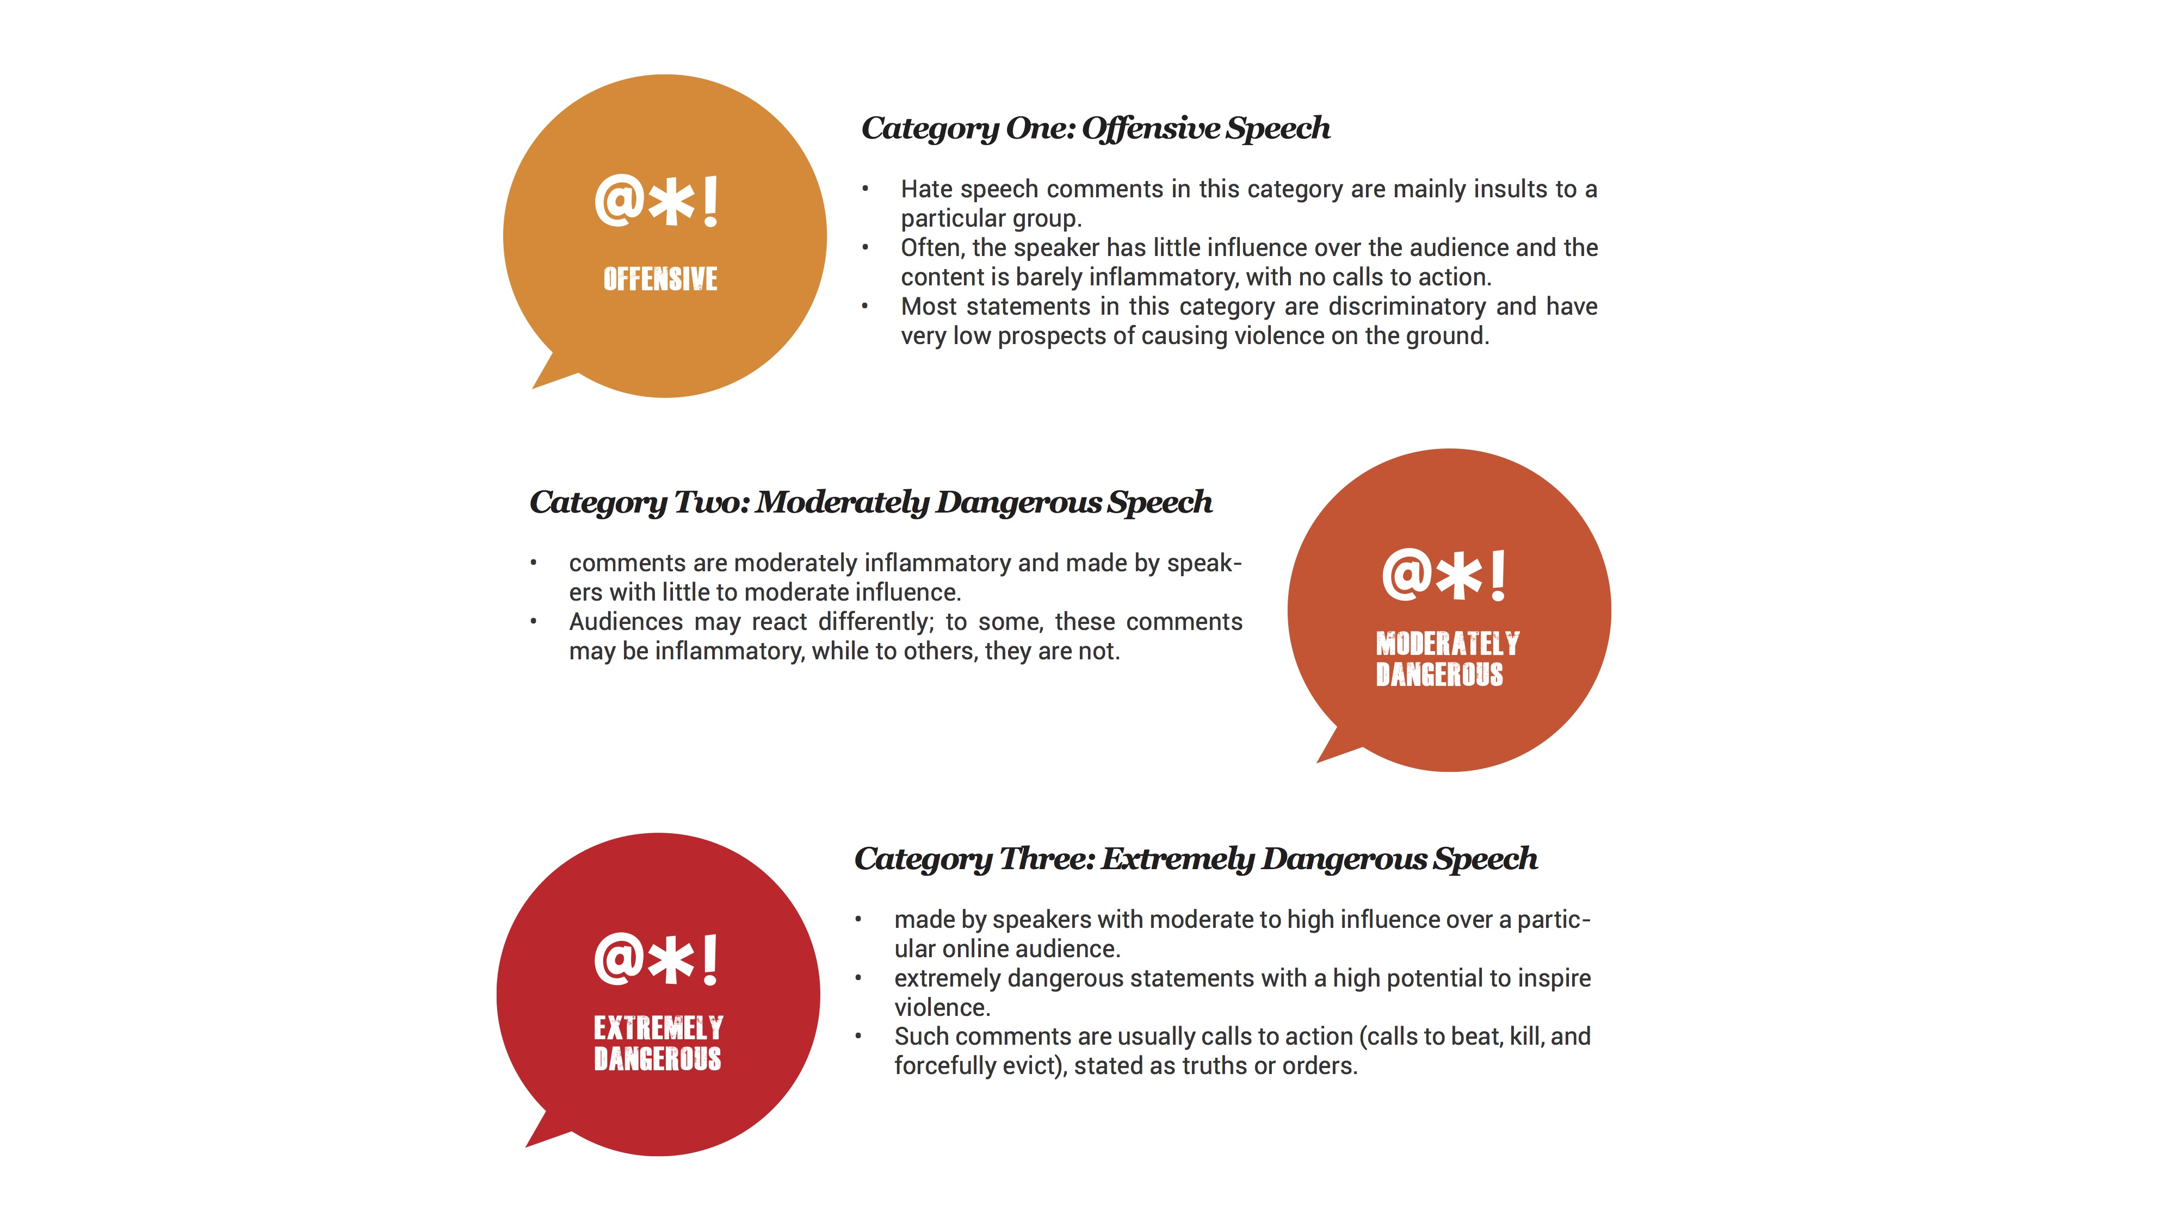
Hate Speech Categories
Notes:
<number>

Slide 10



GOAL 2: Collect and monitor dangerous speech online
11 monitors from different tribes
65+ blogs/forums from different tribes
240+ Facebook groups/pages/users, 310 Twitter
7,000+ dangerous speech statements
Notes:
Definition of hate speech
The 2008 law defines hate speech as that which advocates or encourages violent acts against a specific group, and creates a climate of hate or prejudice, which may, in turn, foster the commission of hate crimes.
Screen Shot 2014-06-18 at 9.50.19 am
<number>

Slide 11
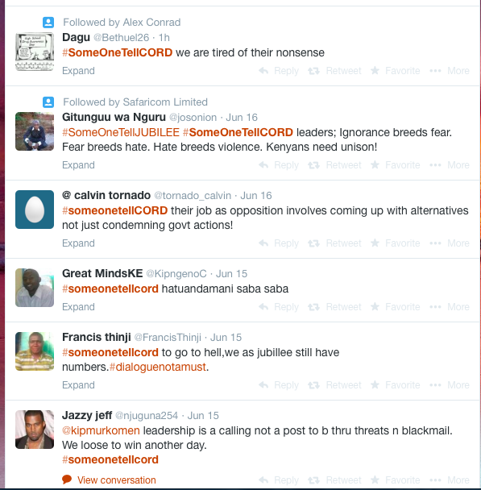


+7000 dangerous speech statements
Window into the conversations at home
KOT cuffing
Everything is hate speech, peace coma
Tweak the framework to suit context
Notes:
1 Hate speech in not a precursor, it is a window.
Address recurring issues.
2. only 3%oftotalhatespeechcomments collected by Umati originated on Twitter, while 90% were found on Facebook. We use this new term, ‘KOT cuffing’, to refer to a phenomenon observed on Twitter where tweets not acceptable by the status quo are openly shunned, and the author of the tweets publicly ridiculed. The end result is that the ‘offender’ is forced to retract statements or even close his/her Twitter account altogether.
3. exploratory survey conducted in May 2013, we found that the public perceives personal insults, propaganda and negative commentary about politicians as hate speech.
The public’s understanding of hate speech is also broader than the current constitutional definition, which only takes into consideration discrimination on tribal lines.
Protect freedom of expression
4. Umati defines dangerous speech as a subset of hate speech that contains three out of the five possible calls to action, as defined by Benesch. Narrowing the definition of dangerous speech further was done in order to fit the Kenyan context. For example, stereotypical insults across tribes can amount to Benesch’s definition of dangerous speech, however, applied to the Kenyan context, such stereotyping across tribes is usually largely perceived as harmless banter.
Picture sources
http://thyblackman.com/2011/02/14/i-am-my-people/comment-page-1/
<number>

Slide 12
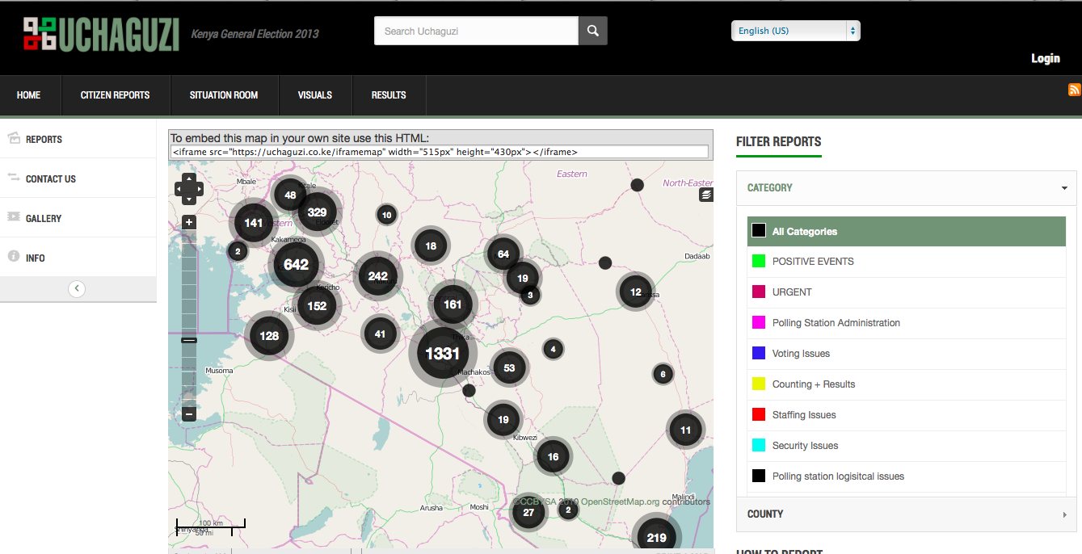

GOAL 3: Forward calls for help
Notes:
We could not have succeeded without our partners
<number>

Slide 13
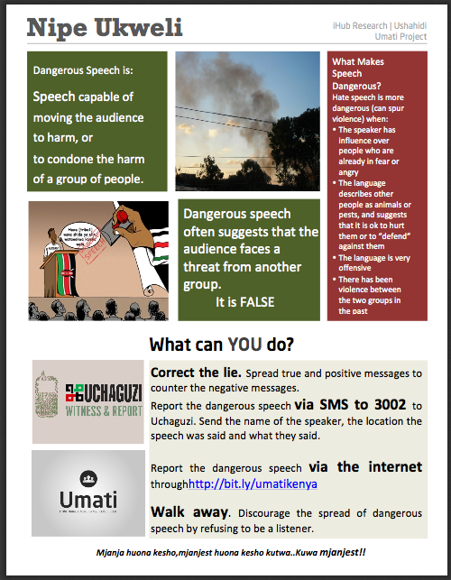
GOAL 4: Sensitize the public
Notes:
The Umati team favours this approach as it gives power to the audience. By defining what type of speech is most harmful to a society, two goals are met:
the mwananchi (citizen) is able to identify which comments/ statements are dangerous and is then able to react responsibly to these statements.
by educating the public on exactly what kind of speech has harmful effects on the community, the public is then able to freely engage in the
speech that is not harmful.
Umati engaged the public through outreach events that promoted education on the matter. Through an awareness campaign dubbed NipeUkweli (Swahili for ‘Give me Truth’), Umati engaged bloggers, community radio, traditional media, and grassroots groups in order to debunk inflammatory rumours and myths, and thus reduce the possible effects of hate speech.
There are several ways an audience can choose to react to hate speech, the audience can:
choose to ignore the statement;
choose not to react to the statement;
educate the speaker to engage in speech that is not dangerous;
offer correct information so the others are encouraged to react
peacefully.
While on air, we managed to discuss the following:
●
The h
istory of Umati
research project
and
our
goals
;
●
Hate speech
and the various categories of hate speech
;
●
Means used to
spread hate speech
;
●
How U
mati is monitoring hate speech;
●
Emphasis
on dangerous speech
;
●
How to
identify dangerous hate speech;
●
Ways of countering dangerous hate speech by using #NipeUkweli
;
●
How to us
e
the
Uchaguzi platform
;
●
Benefits of reporting to Uchaguzi
Picture source:
http://www.jhr.ca/blog/tag/gender-equality/
<number>

Slide 14
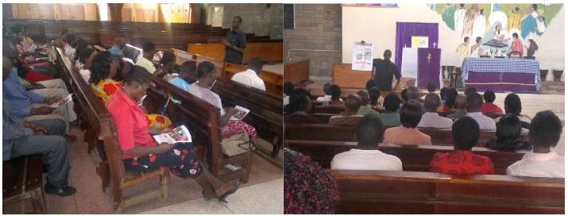
GOAL 4: Sensitize the public
Notes:
The Umati team favours this approach as it gives power to the audience. By defining what type of speech is most harmful to a society, two goals are met:
the mwananchi (citizen) is able to identify which comments/ statements are dangerous and is then able to react responsibly to these statements.
by educating the public on exactly what kind of speech has harmful effects on the community, the public is then able to freely engage in the
speech that is not harmful.
Umati engaged the public through outreach events that promoted education on the matter. Through an awareness campaign dubbed NipeUkweli (Swahili for ‘Give me Truth’), Umati engaged bloggers, community radio, traditional media, and grassroots groups in order to debunk inflammatory rumours and myths, and thus reduce the possible effects of hate speech.
There are several ways an audience can choose to react to hate speech, the audience can:
choose to ignore the statement;
choose not to react to the statement;
educate the speaker to engage in speech that is not dangerous;
offer correct information so the others are encouraged to react
peacefully.
While on air, we managed to discuss the following:
●
The h
istory of Umati
research project
and
our
goals
;
●
Hate speech
and the various categories of hate speech
;
●
Means used to
spread hate speech
;
●
How U
mati is monitoring hate speech;
●
Emphasis
on dangerous speech
;
●
How to
identify dangerous hate speech;
●
Ways of countering dangerous hate speech by using #NipeUkweli
;
●
How to us
e
the
Uchaguzi platform
;
●
Benefits of reporting to Uchaguzi
Picture source:
http://www.jhr.ca/blog/tag/gender-equality/
<number>

Slide 15
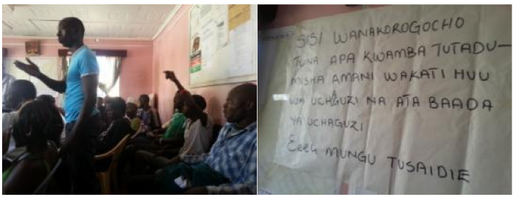
GOAL 4: Sensitize the public
Notes:
The Umati team favours this approach as it gives power to the audience. By defining what type of speech is most harmful to a society, two goals are met:
the mwananchi (citizen) is able to identify which comments/ statements are dangerous and is then able to react responsibly to these statements.
by educating the public on exactly what kind of speech has harmful effects on the community, the public is then able to freely engage in the
speech that is not harmful.
Umati engaged the public through outreach events that promoted education on the matter. Through an awareness campaign dubbed NipeUkweli (Swahili for ‘Give me Truth’), Umati engaged bloggers, community radio, traditional media, and grassroots groups in order to debunk inflammatory rumours and myths, and thus reduce the possible effects of hate speech.
There are several ways an audience can choose to react to hate speech, the audience can:
choose to ignore the statement;
choose not to react to the statement;
educate the speaker to engage in speech that is not dangerous;
offer correct information so the others are encouraged to react
peacefully.
While on air, we managed to discuss the following:
●
The h
istory of Umati
research project
and
our
goals
;
●
Hate speech
and the various categories of hate speech
;
●
Means used to
spread hate speech
;
●
How U
mati is monitoring hate speech;
●
Emphasis
on dangerous speech
;
●
How to
identify dangerous hate speech;
●
Ways of countering dangerous hate speech by using #NipeUkweli
;
●
How to us
e
the
Uchaguzi platform
;
●
Benefits of reporting to Uchaguzi
Picture source:
http://www.jhr.ca/blog/tag/gender-equality/
<number>

Slide 16
Other benefits of Umati
Reference point for people in Kenya to think about what ethnicity, online censorship, internet governance means in the online context
Reference point for people around the world to develop similar initiatives
Innovative method for assessing online behaviour and promoting other pro-peace efforts
Able to facilitate another country pilot (Ethiopia), and now to replicate in Nigeria as part of Phase 2.
Notes:
<number>

Slide 17
Challenges of Umati
Estimating speech ‘dangerousness’ is somewhere between an art and a science.
Highly specific to a country
Mapping the effect of speech form the online to the offline space is difficult
We needed (and still need) even more partners to effect the work that was beyond our scope
Notes:
Umati is essentially trying to draw lines in a continuum of speech where often it is quite hard to draw lines.
Not only does hate speech itself change in color and flavor, the online space itself is also constantly in flux.
Thus, developing a system to capture and track hate speech online continues to be a challenging feat.
<number>

Slide 18
Thank You!
Notes:
<number>

